Slide 1
Client-Server communication in C#
With blocking collection

Slide 2
Agenda
The end goal
Client <-> Server socket communication

Slide 3
Where we want to end up

Slide 4
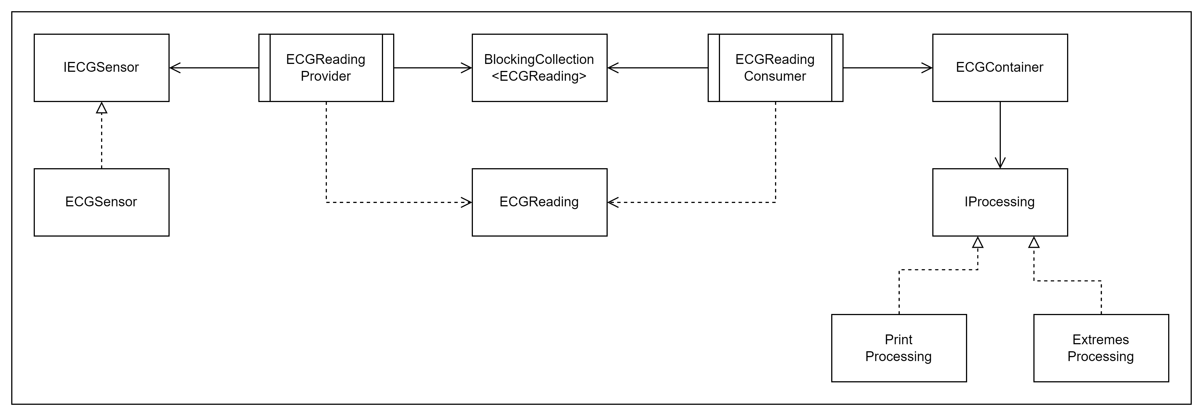
We want to go from this

Slide 5
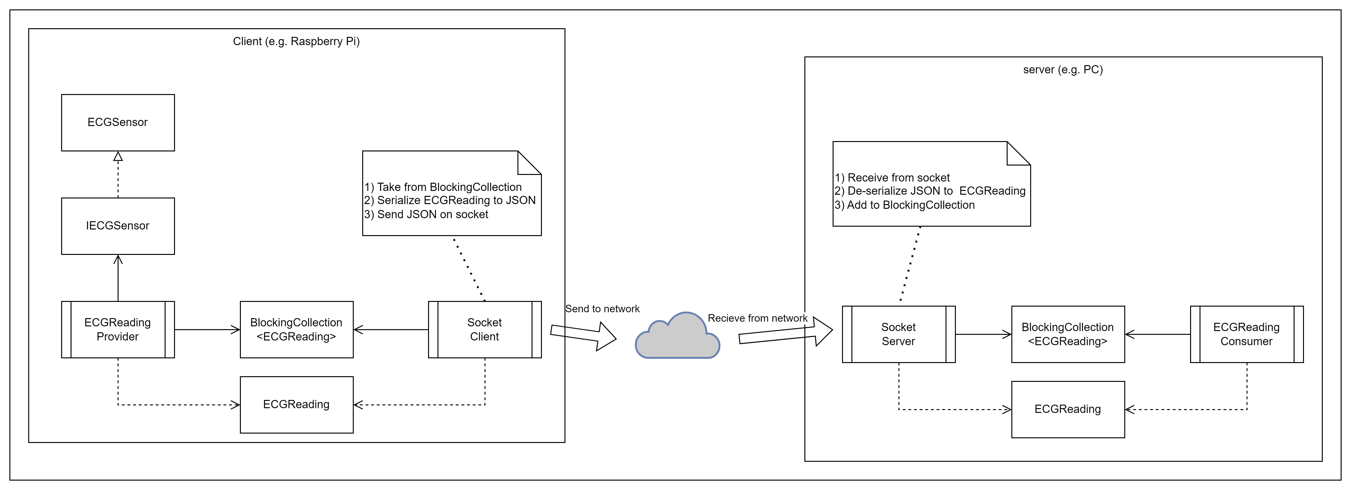
To this

Slide 6
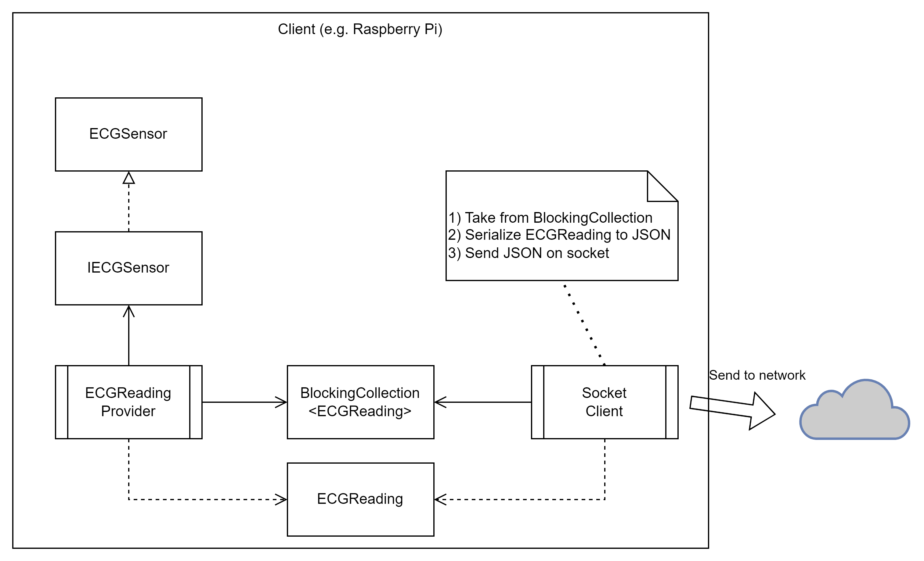
Client

Slide 7
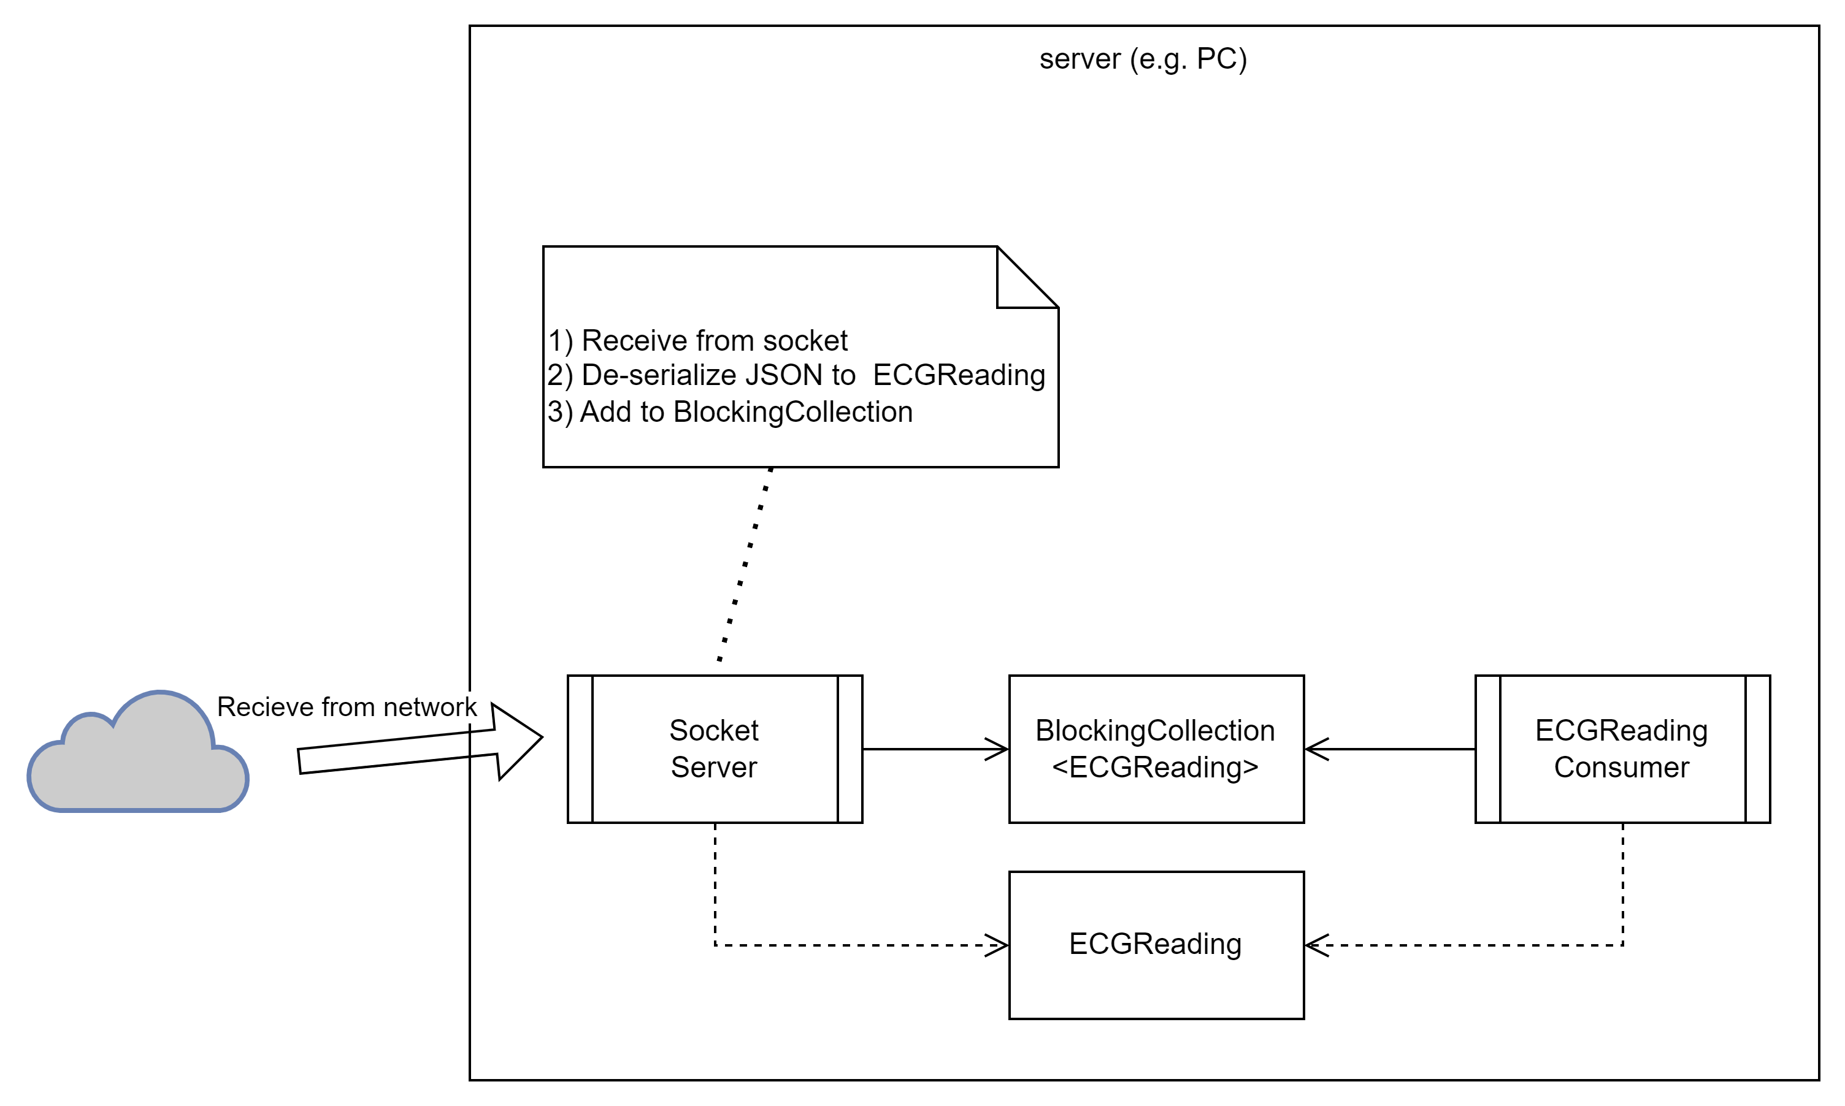
Server

Slide 8
Socket communication

Slide 9
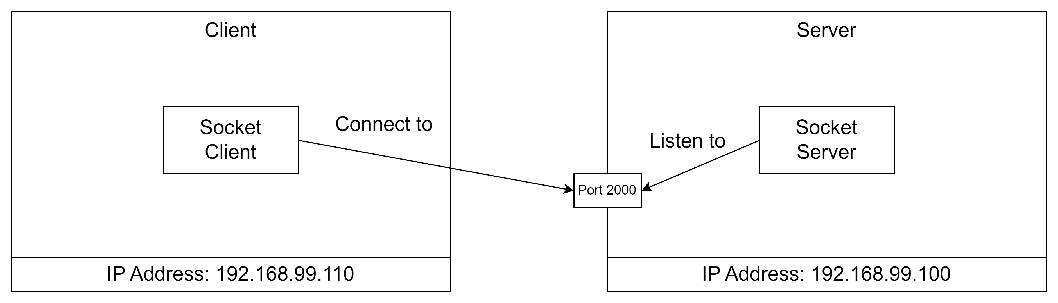
The server listens
The Server specifies where to listen:
IP Address
Port number

Slide 10
The server listens
The server can have multiple network cards and more than one address.
IP Address to listen to can be:
Any <= all network interfaces
Loopback <= 127.0.0.1
A specific IP address
The Server specifies where to listen:
IP Address
Port number

Slide 11
The client connects to the server
The client connects to a server socket:
IP Address
Port number

Slide 12
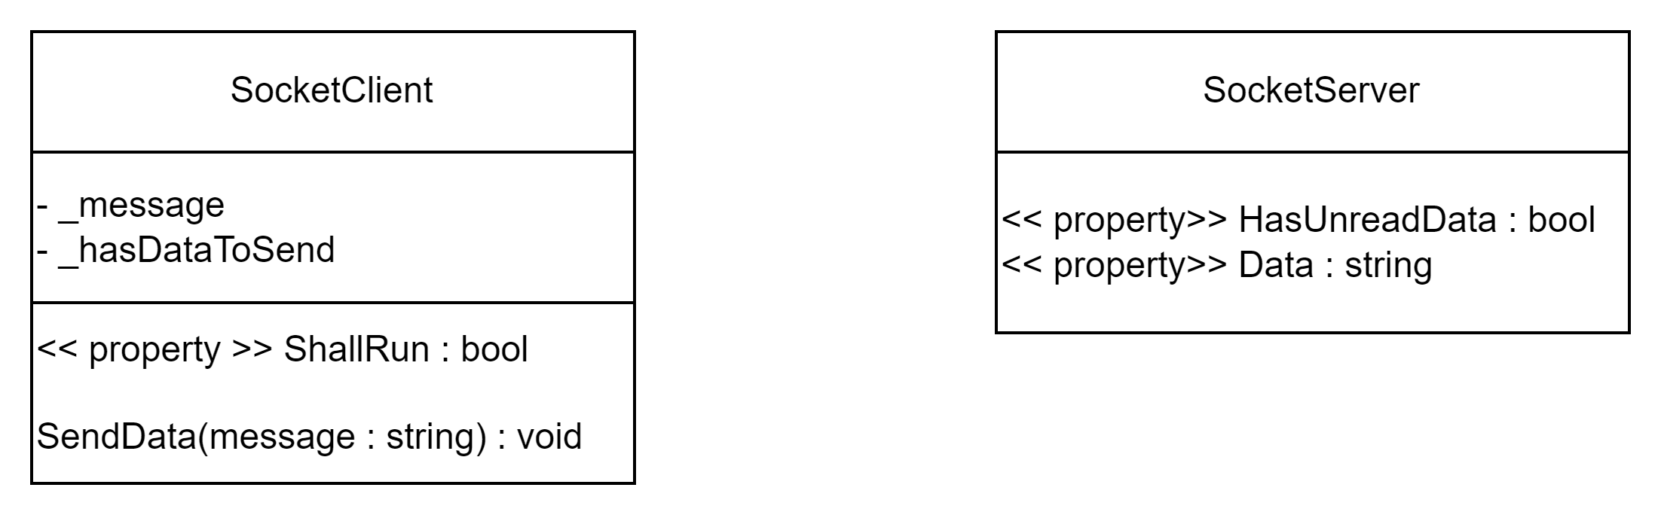
Using the socket communication from other threads
Notes:
We have added a SendData method to the client and public properties to the server, through which data can be read.

Slide 13


Slide 14
Problems in this approach
There are some problems with the way we do this:
What if SendData() is called more than once, before the data is sent on the socket?
What if SendData() is called before _hasDataToSend is reset?
What if a user of the SocketServer reads the Data property at the same time as data is received?

Slide 15
Problems in this approach
There are some problems with the way we do this:
What if SendData() is called more than once, before the data is sent on the socket?
What if SendData() is called before _hasDataToSend is reset?
What if a user of the SocketServer reads the Data property at the same time as data is received?
Some data might be lost!

Slide 16
Problems in this approach
There are some problems with the way we do this:
What if SendData() is called more than once, before the data is sent on the socket?
What if SendData() is called before _hasDataToSend is reset?
What if a user of the SocketServer reads the Data property at the same time as data is received?
We will fix this in the coming weeks ☺

Slide 17
Problems in this approach
There are some problems with the way we do this:
What if SendData() is called more than once, before the data is sent on the socket?
What if SendData() is called before _hasDataToSend is reset?
What if a user of the SocketServer reads the Data property at the same time as data is received?
We will fix this NOW!

Slide 18
Better approach

Slide 19
Sending objects from the client
internal class SocketClient
{
private readonly BlockingCollection<ECGReading> _ecgReadings;
public SocketClient(BlockingCollection<ECGReading> ecgReadings)
{
_ecgReadings = ecgReadings;
}
public void Run()
{
IPAddress ipAddress = IPAddress.Parse("127.0.0.1");
IPEndPoint ipEndPoint = new IPEndPoint(ipAddress, 2000);
using Socket client = new Socket(ipEndPoint.AddressFamily, SocketType.Stream, ProtocolType.Tcp);
client.Connect(ipEndPoint);
while (!_ecgReadings.IsCompleted)
{
try
{
ECGReading ecgReading = _ecgReadings.Take();
string objectAsJson = JsonSerializer.Serialize(ecgReading);
var messageBytes = Encoding.UTF8.GetBytes(objectAsJson);
client.Send(messageBytes, SocketFlags.None);
Console.WriteLine($"Socket client sent message: {objectAsJson}");
}
catch (InvalidOperationException)
{
// IOE means that Take() was called on a completed collection.
}
}
client.Shutdown(SocketShutdown.Both);
}
}

Slide 20
Sending objects from the client
internal class SocketClient
{
private readonly BlockingCollection<ECGReading> _ecgReadings;
public SocketClient(BlockingCollection<ECGReading> ecgReadings)
{
_ecgReadings = ecgReadings;
}
public void Run()
{
IPAddress ipAddress = IPAddress.Parse("127.0.0.1");
IPEndPoint ipEndPoint = new IPEndPoint(ipAddress, 2000);
using Socket client = new Socket(ipEndPoint.AddressFamily, SocketType.Stream, ProtocolType.Tcp);
client.Connect(ipEndPoint);
while (!_ecgReadings.IsCompleted)
{
try
{
ECGReading ecgReading = _ecgReadings.Take();
string objectAsJson = JsonSerializer.Serialize(ecgReading);
var messageBytes = Encoding.UTF8.GetBytes(objectAsJson);
client.Send(messageBytes, SocketFlags.None);
Console.WriteLine($"Socket client sent message: {objectAsJson}");
}
catch (InvalidOperationException)
{
// IOE means that Take() was called on a completed collection.
}
}
client.Shutdown(SocketShutdown.Both);
}
}

Slide 21
Sending objects from the client
internal class SocketClient
{
private readonly BlockingCollection<ECGReading> _ecgReadings;
public SocketClient(BlockingCollection<ECGReading> ecgReadings)
{
_ecgReadings = ecgReadings;
}
public void Run()
{
IPAddress ipAddress = IPAddress.Parse("127.0.0.1");
IPEndPoint ipEndPoint = new IPEndPoint(ipAddress, 2000);
using Socket client = new Socket(ipEndPoint.AddressFamily, SocketType.Stream, ProtocolType.Tcp);
client.Connect(ipEndPoint);
while (!_ecgReadings.IsCompleted)
{
try
{
ECGReading ecgReading = _ecgReadings.Take();
string objectAsJson = JsonSerializer.Serialize(ecgReading);
var messageBytes = Encoding.UTF8.GetBytes(objectAsJson);
client.Send(messageBytes, SocketFlags.None);
Console.WriteLine($"Socket client sent message: {objectAsJson}");
}
catch (InvalidOperationException)
{
// IOE means that Take() was called on a completed collection.
}
}
client.Shutdown(SocketShutdown.Both);
}
}

Slide 22
Receiving objects on the server
internal class SocketServer
{
private readonly BlockingCollection<ECGReading> _ecgReadings;
public SocketServer(BlockingCollection<ECGReading> ecgReadings)
{
_ecgReadings = ecgReadings;
}
public void Run()
{
RunServer();
}
public void RunServer()
{
// listen to 'Any' which means all network addresses for this machine
IPAddress ipAddress = IPAddress.Any;
IPEndPoint ipEndPoint = new IPEndPoint(ipAddress, 2000);
using Socket listener = new Socket(ipEndPoint.AddressFamily, SocketType.Stream, ProtocolType.Tcp);
listener.Bind(ipEndPoint);
Console.WriteLine($"Listening on: {ipAddress}");
listener.Listen();
var handler = listener.Accept();
while (!ShallStop)
{
byte[] buffer = new byte[1024];
int numberOfBytesReceived = handler.Receive(buffer, SocketFlags.None);
if (numberOfBytesReceived > 0)
{
string receivedData = Encoding.UTF8.GetString(buffer, 0, numberOfBytesReceived);
Console.WriteLine($"Server received:{receivedData}");
try
{
ECGReading? ecgReading = JsonSerializer.Deserialize<ECGReading>(receivedData);
if (ecgReading != null) _ecgReadings.Add(ecgReading);
}
catch (System.Text.Json.JsonException e)
{
// log any parsing exceptions
Console.WriteLine(e);
}
}
}
listener.Close();
_ecgReadings.CompleteAdding();
}
public bool ShallStop { get; set; } = false;
}

Slide 23
Receiving objects on the server
internal class SocketServer
{
private readonly BlockingCollection<ECGReading> _ecgReadings;
public SocketServer(BlockingCollection<ECGReading> ecgReadings)
{
_ecgReadings = ecgReadings;
}
public void Run()
{
RunServer();
}
public void RunServer()
{
// listen to 'Any' which means all network addresses for this machine
IPAddress ipAddress = IPAddress.Any;
IPEndPoint ipEndPoint = new IPEndPoint(ipAddress, 2000);
using Socket listener = new Socket(ipEndPoint.AddressFamily, SocketType.Stream, ProtocolType.Tcp);
listener.Bind(ipEndPoint);
Console.WriteLine($"Listening on: {ipAddress}");
listener.Listen();
var handler = listener.Accept();
while (!ShallStop)
{
byte[] buffer = new byte[1024];
int numberOfBytesReceived = handler.Receive(buffer, SocketFlags.None);
if (numberOfBytesReceived > 0)
{
string receivedData = Encoding.UTF8.GetString(buffer, 0, numberOfBytesReceived);
Console.WriteLine($"Server received:{receivedData}");
try
{
ECGReading? ecgReading = JsonSerializer.Deserialize<ECGReading>(receivedData);
if (ecgReading != null) _ecgReadings.Add(ecgReading);
}
catch (System.Text.Json.JsonException e)
{
// log any parsing exceptions
Console.WriteLine(e);
}
}
}
listener.Close();
_ecgReadings.CompleteAdding();
}
public bool ShallStop { get; set; } = false;
}

Slide 24
Receiving objects on the server
internal class SocketServer
{
private readonly BlockingCollection<ECGReading> _ecgReadings;
public SocketServer(BlockingCollection<ECGReading> ecgReadings)
{
_ecgReadings = ecgReadings;
}
public void Run()
{
RunServer();
}
public void RunServer()
{
// listen to 'Any' which means all network addresses for this machine
IPAddress ipAddress = IPAddress.Any;
IPEndPoint ipEndPoint = new IPEndPoint(ipAddress, 2000);
using Socket listener = new Socket(ipEndPoint.AddressFamily, SocketType.Stream, ProtocolType.Tcp);
listener.Bind(ipEndPoint);
Console.WriteLine($"Listening on: {ipAddress}");
listener.Listen();
var handler = listener.Accept();
while (!ShallStop)
{
byte[] buffer = new byte[1024];
int numberOfBytesReceived = handler.Receive(buffer, SocketFlags.None);
if (numberOfBytesReceived > 0)
{
string receivedData = Encoding.UTF8.GetString(buffer, 0, numberOfBytesReceived);
Console.WriteLine($"Server received:{receivedData}");
try
{
ECGReading? ecgReading = JsonSerializer.Deserialize<ECGReading>(receivedData);
if (ecgReading != null) _ecgReadings.Add(ecgReading);
}
catch (System.Text.Json.JsonException e)
{
// log any parsing exceptions
Console.WriteLine(e);
}
}
}
listener.Close();
_ecgReadings.CompleteAdding();
}
public bool ShallStop { get; set; } = false;
}

Slide 25
Receiving objects on the server
internal class SocketServer
{
private readonly BlockingCollection<ECGReading> _ecgReadings;
public SocketServer(BlockingCollection<ECGReading> ecgReadings)
{
_ecgReadings = ecgReadings;
}
public void Run()
{
RunServer();
}
public void RunServer()
{
// listen to 'Any' which means all network addresses for this machine
IPAddress ipAddress = IPAddress.Any;
IPEndPoint ipEndPoint = new IPEndPoint(ipAddress, 2000);
using Socket listener = new Socket(ipEndPoint.AddressFamily, SocketType.Stream, ProtocolType.Tcp);
listener.Bind(ipEndPoint);
Console.WriteLine($"Listening on: {ipAddress}");
listener.Listen();
var handler = listener.Accept();
while (!ShallStop)
{
byte[] buffer = new byte[1024];
int numberOfBytesReceived = handler.Receive(buffer, SocketFlags.None);
if (numberOfBytesReceived > 0)
{
string receivedData = Encoding.UTF8.GetString(buffer, 0, numberOfBytesReceived);
Console.WriteLine($"Server received:{receivedData}");
try
{
ECGReading? ecgReading = JsonSerializer.Deserialize<ECGReading>(receivedData);
if (ecgReading != null) _ecgReadings.Add(ecgReading);
}
catch (System.Text.Json.JsonException e)
{
// log any parsing exceptions
Console.WriteLine(e);
}
}
}
listener.Close();
_ecgReadings.CompleteAdding();
}
public bool ShallStop { get; set; } = false;
}

Slide 26

Your turn
Solve the
” Exercise - ECG Network”

Slide 27
References and image sources
Warning tape: https://www.pngall.com/warning-sign-png/download/69428

